Slide 1


FRAMEWORK APLIKASI WEB
JIHADUL AKBAR

Slide 2


What Is Framework ?
30 cm
40 cm
1 Lembar
1000 Lembar
z
Bingkai Potong

Slide 3
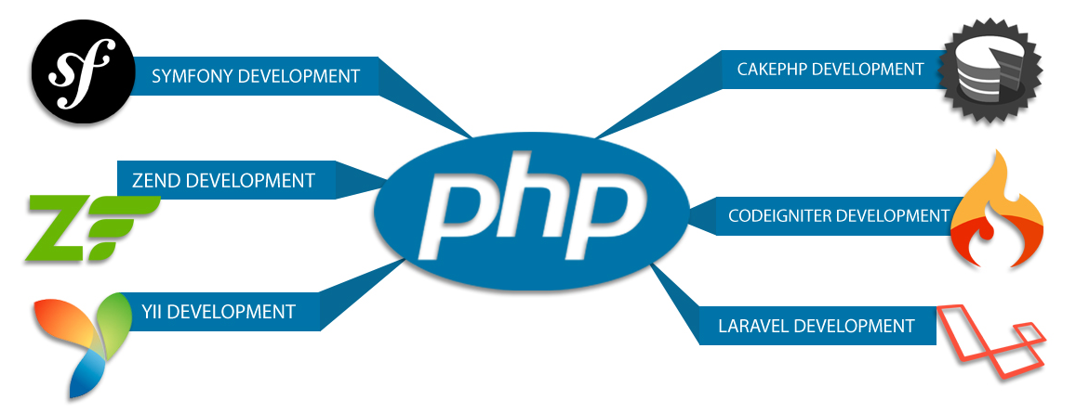
Macam – macam Framework

Slide 4
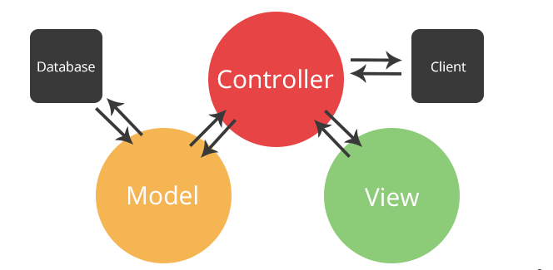
Model View Contriller (MVC)

Slide 5
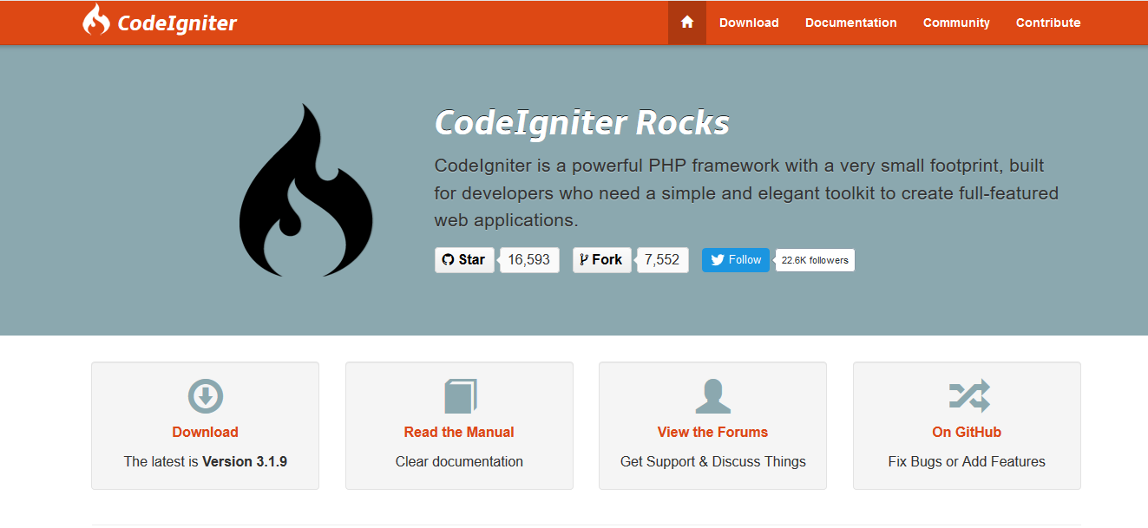
CodeIgniter https://www.codeigniter.com/

Slide 6
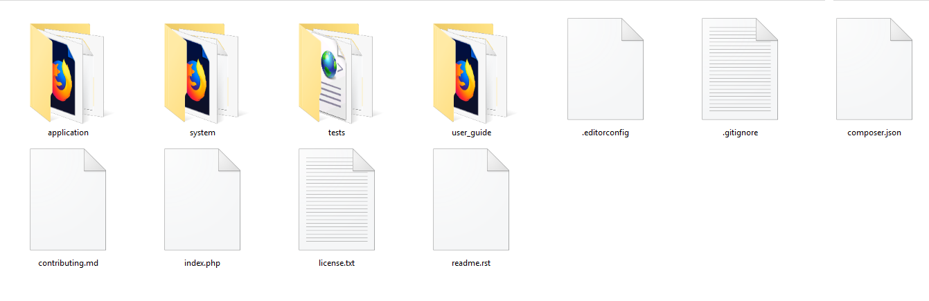
Core CodeIgniter The latest is Version 3.1.9

Slide 7
Installation CodeIgniter The latest is Version 3.1.9
Download CodeIgniter From Web www.codeigniter.com
Extract file and copy to xampp/htdoc/
Test from browser open folder that was copy in htdoc
If success you will see welcome page
Yehh you are success install codeingniter ☺

Slide 8
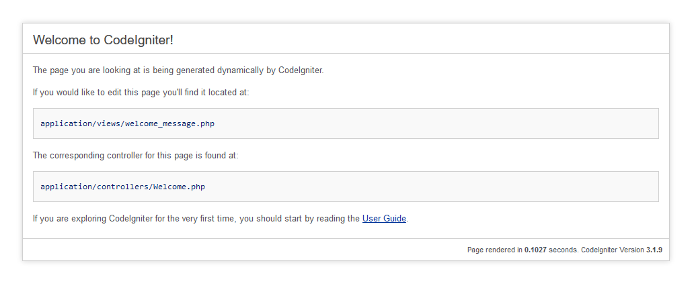
Welcome CodeIgniter The latest is Version 3.1.9

Slide 9
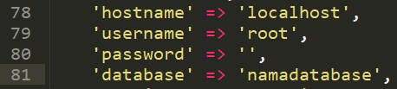
Setting CodeIgniter The latest is Version 3.1.9
Folder ./appliaction/config/config.php
Folder ./application/config/database.php
Folder ./application/config/

Slide 10

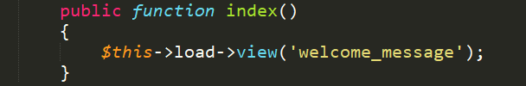
Controller CodeIgniter The latest is Version 3.1.9
Name the controller and class must Uppercase.
Public function index(){} is index controller
$this->load->view(‘welcome_massage’) this use for load view.

Slide 11


Thank You ☺
See you

